Slide 1
WELCOME TO THE CLIMATE COACHING ALLIANCE Date

Slide 2
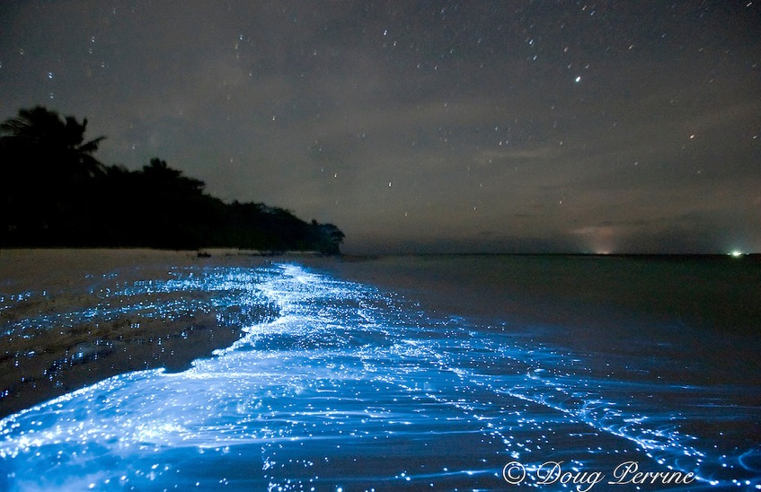
PURPOSE: TRANSFORMING OUR PRACTICE; TRANSFORMING OUR IMPACT; TRANSFORMING THE PROFESSION
Participating in the positive shift in human awareness to effect wider systemic changes in the world towards a truly regenerative future. “To give life to the forest of life”.
We influence the global professional coaching community to bring the deep and difficult questions of climate and ecological emergency into coaching conversations.
If we are magnificently successful, our current role will no longer be needed by 2025. We are:
Open and free, following living systems principles to allow the complexity and possibility within the widest set of relationships, offerings and shared intelligence to emerge and ripple.
2,300 + members strong across 6 continents with many sub communities – geographic and by language and interest.
Run entirely by volunteers so please consider how you might contribute.
Notes:
Purpose and aims:
To create a Climate Coaching Alliance for coaches, coaching psychologists, and coaching supervisors, facilitators and other leadership professionals providing a space to share resources, explore practice, and hold dialogue.
We aim:
to enable influence and support the evolution of coaches (and aligned professions) coaching practice and the profession to step into the necessary leadership role in the face of our climate and ecological emergency.
to resource ourselves and to create spaces to process, as needed, when we find ourselves both personally and professionally affected by powerful emotions generated by the climate and ecological emergency we are in
We are
Open to all professional coaching and coaching psychology bodies, not aligned to one over another.
Open access to all individuals and organizations signed up to the Alliance, we aspire to be able to provide resources such as articles, links to websites, access to conversations.
Global reach with people from all parts of the globe, including coaches in communities who are already more impacted by the ecological and climate emergency, this is particularly important to enable us to respond and ‘hold’ a stance that is respectful, grounded in ‘what is’ and trusted
Offering and promoting free virtual events accessible to all. We offer these events who ever they are created by as long as they align with our purpose and aims
Facilitating and enabling self-organising communities to develop around the world

Slide 3
Why CCA? Vision and purpose
We participate in a positive shift in human awareness, to effect wider systemic changes in the world towards a truly regenerative future.
“To give life to the forest of life”.
We influence the global professional coaching community to bring in the deep and difficult questions of climate and ecological emergency into coaching conversations.
If we are magnificently successful, our current role will no longer be needed by 2025.
https://www.climatecoachingalliance.org/vision-and-purpose/
Notes:
7/60
Ask other to share their understanding of our vision

Slide 4
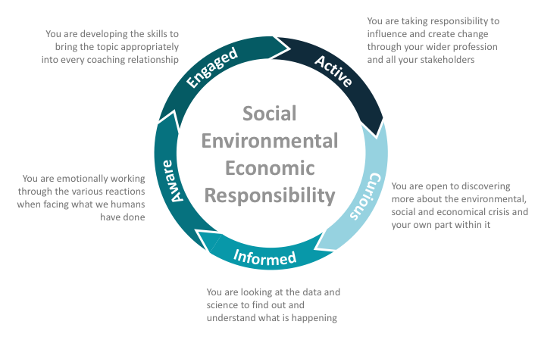
THE ECO-PHASE CYCLE: FROM PERMISSION TO ACTION
Copyright © Professor Peter Hawkins, Renewal Associates

Slide 5
LOCAL & LANGUAGE COMMUNITIES
Emerging
CCA UK
South West
CCA Portuguese
Established
CCA FR
CCA UK Yorkshire
CCA Turkish
CCA
USA
CCA Asia
CCA Canada
CCA Africa
CCA
Italy
CCA Spanish
CCA UK
South
CCA AUS & NZ
CCA German
CCA Indonesia
Where
next?
CCA Japan
CCA Malaysia
CCA Quebec
Notes:
New pods emerging

Slide 6
COMMUNITIES OF INTEREST (PODS)
Organizing Pods
Needs attention
Established communities
New Members
Festival
New Members
Emerging
Events/ Special Events
Communities/pods
Co-evolving a life affirming culture
Research
CORE
Co-ordinating
Inter-generational/ youth voices
Sustainability
Website
Political
Work & Green Careers
Media
Seedbank
Deep Adaptation
Healing
Story
telling
Climate Change & Coaching Education
Notes:
Never change by fighting the existing reality - build a new model that makes the old obsolete - Buckmeister Fuller

Slide 7
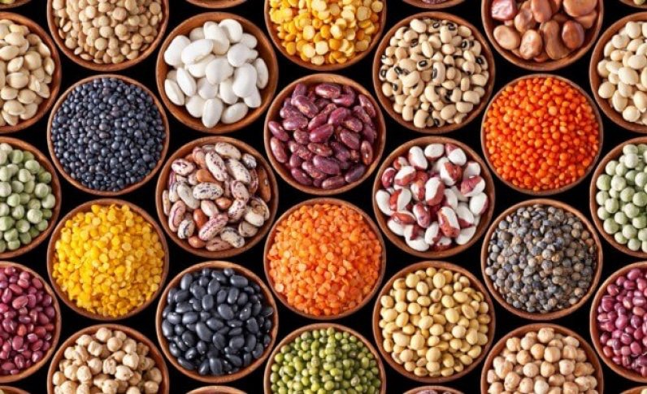
OUR SEEDBANK
Members share resources they have found useful
The Seed captures their learning and what they discovered using that resources
Seeds are crafted by coaches for coaches
https://www.climatecoachingalliance.org/seedbank/
Image sourced: https://geneticliteracyproject.org/2018/03/22/open-source-seed-producers-us-india-changing-global-food-production-2/

Slide 8
EVENTS
Do check this page:
https://www.climatecoachingalliance.org/events/
Events
Inspirations
Energy
Connections
Next steps to more sustainability in our and our clients' lives
Photo by Roberto Lopez on Unsplash

Slide 9
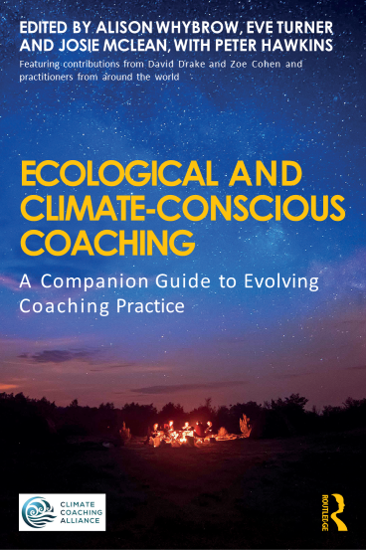
Ecological and Climate-Conscious Coaching A Companion Guide to Evolving Coaching Practice
OUT NOW!! Get Your Copy Today
"This is a book of insightful journeys over seven days, reflecting on the ecological and climate crisis and the important role coaching can play... and will inform both trainee and experienced coaching practitioners with what they need to know about eco-engaged practice.'" Get 20% Discount at Routledge when you use code: FLA22.

Slide 10
WEBSITE: HTTPS://WWW.CLIMATECOACHINGALLIANCE.ORG/ LINKEDIN GROUP & PAGE https://www.linkedin.com/company/climate-coaching-alliance/?viewAsMember=true https://www.linkedin.com/groups/13858987/ FACEBOOK https://www.facebook.com/climatecoaching/ NEW MEMBER PODS CONTACT (Aya Usui) membership@climatecoachingalliance.org
Let’s Explore:
Notes:
https://www.climatecoachingalliance.org/
https://www.linkedin.com/groups/13858987/

